Slide 1

MRIO
An Ontology for MRI Acquisition and Analysis
https://github.com/Buffalo-Ontology-Group/MRI_Ontology

Slide 2
Outline
Background on MRI and neuroimaging
Previous work on MRIO
General terms to contribute to OBI
Scan classification logic
Use cases
Conclusion/Action items

Slide 3
MRI And Neuroimaging ANALYSIS

Slide 4
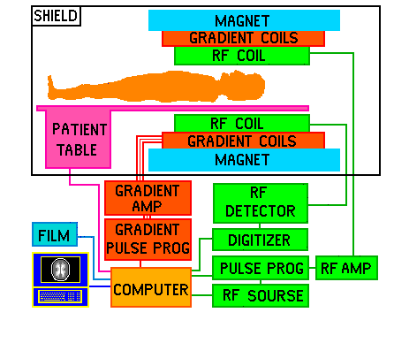
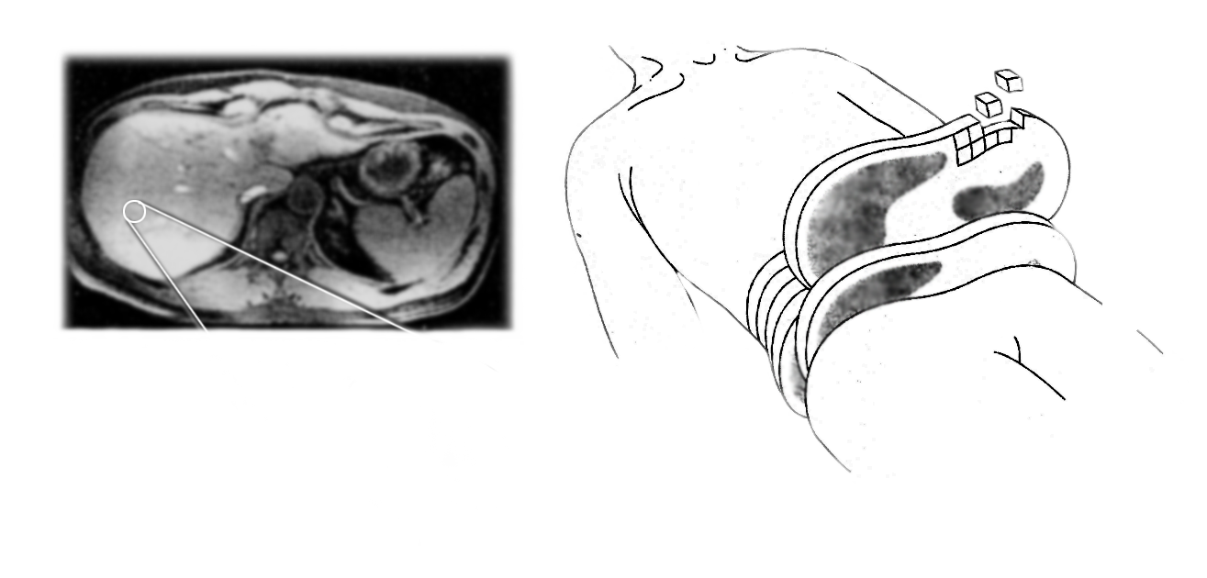
MRI
Biomedical imaging technique used to acquire (typically) 3D images to observe the structure or function of some tissue
Uses strong magnetic fields to acquire images via contrast from the inherent properties of the tissue examined
Commonly found in most clinics, noninvasive, and reliable
Images typically in the form of DICOM files
Standard file format used across many imaging modalities
File header includes vast amount of data on the subject scanned, how the scan was acquired, make up of the digital image, etc.

Slide 5
MRI Acquisition
Physics of MRI acquisition rooted in “spin” of protons in tissue (Plewes DB, et al. 2012)
Angular momentum and magnetic dipole moment
MRI machine comprised of primary superconducting magnet, three sets of gradient coils, and radio frequency (RF) coils
Protons aligned to main magnetic field (B₀)
Gradient coils introduce variations in B₀ in x,y,z direction, providing spatial encoding
RF coils pass RF pulses through field, disturbing protons’ alignments/spins
Protons re-align with magnetic field, releasing energy in the process (“relaxation”)
RF coils receive this energy, which is then processed into digital data encoding n-dimensional array of image voxels, subject data, acquisition parameters, etc.
Echo time (TE) – time between RF pulse and peak of signal received
Repetition time (TR) – time between two RF pulses
Flip angle (FA) – degree a proton shifts in transverse plane from RF pulse

Slide 6
DICOM Headers and MRI Acquisition
MRI technician chooses MRI acquisition parameters following a chosen scanning protocol
MRI technician enters MRI acquisition parameters into MRI machine settings
These acquisition parameters are encoded in DICOM headers as standard tags
This use of standardized tags allows an experienced biomedical imaging specialist to deduce information about a scan’s acquisition and type

Slide 7
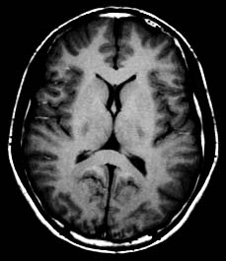
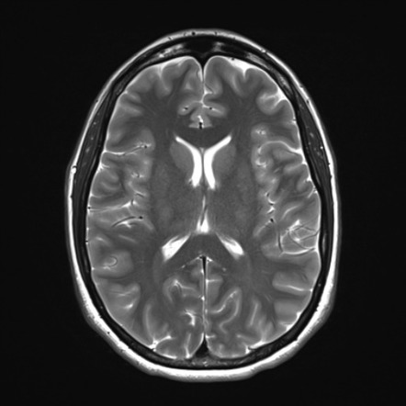
MRI Acquisition: contrast, types, and relaxation
Different kinds of images can be acquired by tuning the MRI machine settings to focus on different proton relaxation (creates difference kinds of contrast)
T1 relaxation (T1 weighted image)
Spin-lattice relaxation
T2 relaxation (T2 weighted image)
Spin-spin relaxation
And others
Proton density
T1
T2

Slide 8
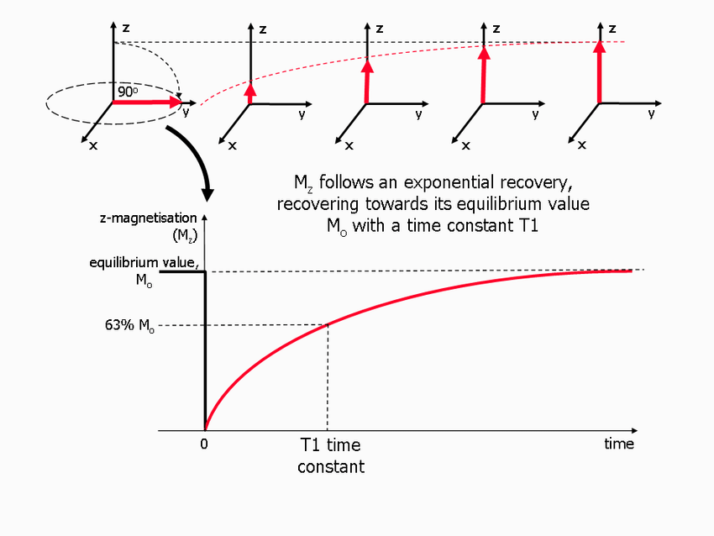
T1 weighted image acquisition
Spin-Lattice Relaxation
Shortly after being flipped to point at the receiver coil, protons tend to realign themselves with the static magnetic field
Relaxation time is different for different tissues, depending on the “freedom” of the hydrogen atoms
Shorter TE and TR
Substances like fat have quick T1 times, whereas water, CSF, etc., have slow T1 times

Slide 9
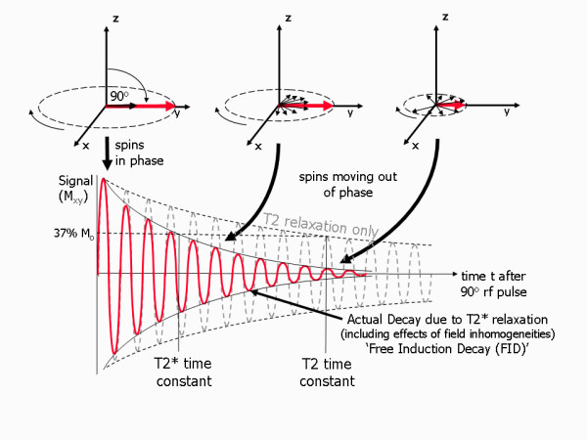
T2 weighted image acquisition
Spin-Spin Relaxation
Protons are in reality constantly rotating around external field axis
All rotating in step with each other right after being flipped to point at receiver, so signal is constant
Protons quickly lose phase with each other after pulse
Begin to cancel each other out instead of adding up
Generally much faster than T1 relaxation
More immobile nuclei and solids have very short T2 relaxation times

Slide 10
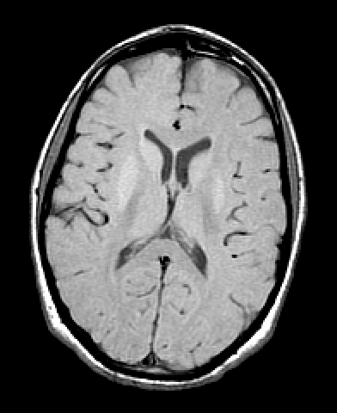
Proton density image acquisition
Short TE diminishes T2 effect
Long TR diminishes T1 effect
More protons in a given area, in the absence of T1 and T2 effects, will produce relatively more signal

Slide 11
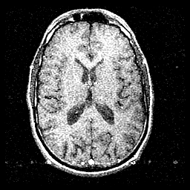
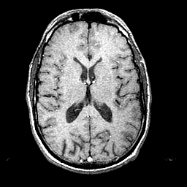
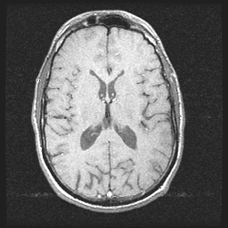
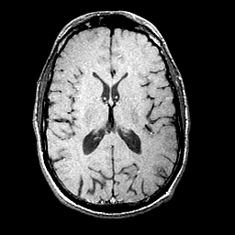
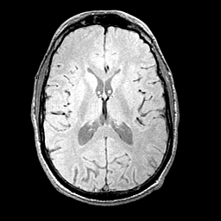
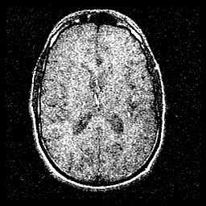
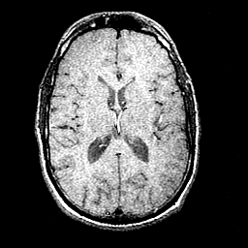
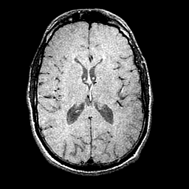
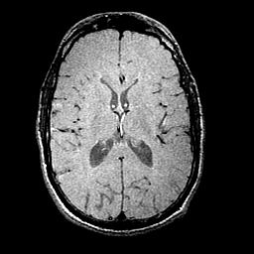
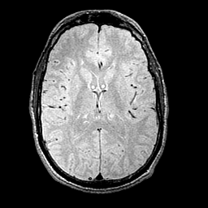
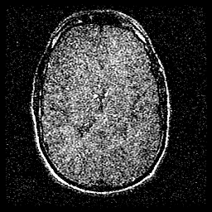
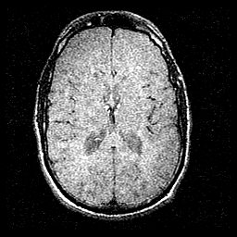
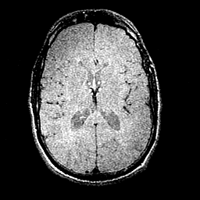
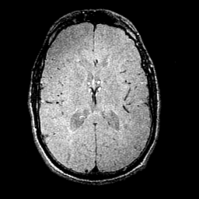
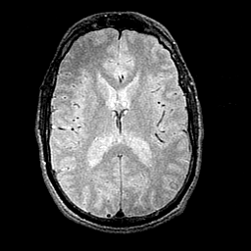
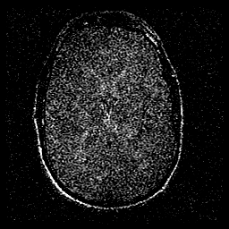
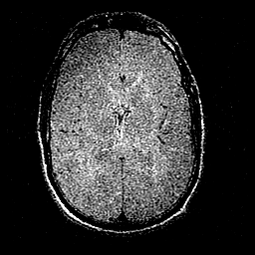
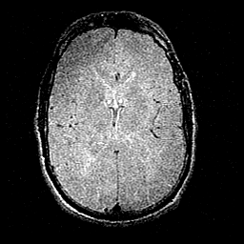
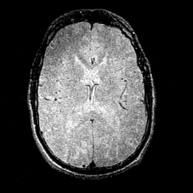
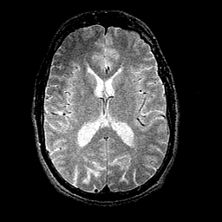
TR (ms)‏
_{T1}
_{PD}
250
500
750
1000
2000
20
40
TE (ms)‏
60
80
_{T2}

Slide 12
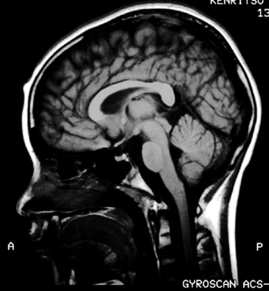
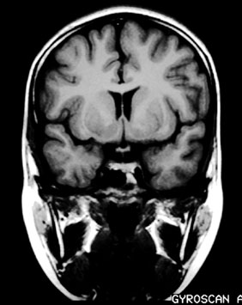
Neuroimaging
Field comprised of (mostly) non-invasive methods for studying the brain and CNS
Includes MRI, PET, CT, etc.
Nearly all use the DICOM standard
Typically uses voxels to construct 3D arrays/images
Useful in clinic and research settings
Diagnosis
Observe structure
Investigate function
Explore brain circuitry (De Castro Caparelli, Elisabeth et al, 2010)

Slide 13
Neuroimaging, despite its many uses, is a niche field
Requires knowledge of CNS anatomy, underlying microbiology, physics, and computer programming
How would a clinical researcher classify this scan and run relevant analyses?

Slide 14
Current state of neuroimaging data and data sharing
Accelerates scientific discovery, but requires strong standards
Something like the Brain Imaging Data Structure (BIDS) specification helps (Gorgolewski et al, 2016)
Complimentary approach for organizing files, not ontologically rooted
Big data == huge effort manually curating and organizing (Poldrack, R. A. et al, 2014)
Gap/Problem
Need ways to standardize across many scanning protocols (Petersen RC et al, 2010)
Need domain expertise to identify scans
Hard to coordinate and run analyses and pipelines
No good way to share data and methods easily
This creates a barrier for researchers interested in asking questions that may be answered by neuroimaging, but may not necessarily have the experience

Slide 15
Limits of Neuroimaging
Lack of standards among tools and data
Need to manually curate large amounts of data
Insufficient means of sharing data
Lack of automation
Rigorous training and expertise needed (High barrier of entry)
Notes:
Frame of high barrier of entry to clinical researchers and scientists who don’t necessarily have time/resources to test ideas

Slide 16
Introducing MRIO
Built on BFO, IAO, OBI
Represents the domain knowledge of acquiring and analyzing MRI
Provides ontologically-based standards for working with MRI data
Helps classify scan types and assign pertinent analyses
Integrates with DICOM standard
Notes:
Frame of high barrier of entry to clinical researchers and scientists who don’t necessarily have time/resources to test ideas

Slide 17
Role for an MRI Ontology (MRIO)
Lack of standards among tools and data
MRIO provides well-reasoned standards and relations between MRI acquisition and the tools used to analyze data
MRIO is compatible with available biomedical imaging data standards (DICOM, BIDS)
Need to manually curate large amounts of data
MRIO aids in data annotation, alleviating time and manpower required for curating large datasets
Insufficient means of sharing data
MRIO helps standardize reporting of MRI data and analysis methods, facilitating data sharing
Lack of automation
MRIO may be used to automate scan classification and analyses
Rigorous training and expertise needed (High barrier of entry)
MRIO captures a formal representation of the domain knowledge of an experienced neuroimaging scientist
Notes:
Frame of high barrier of entry to clinical researchers and scientists who don’t necessarily have time/resources to test ideas

Slide 18
Previous Work

Slide 19
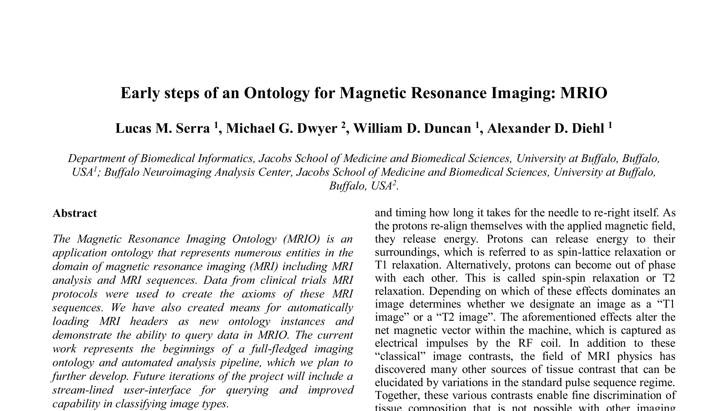
MRIO at ICBO 2019
Development on MRIO began by Dr. Serra and Dr. Diehl in collaboration with Dr. Dwyer, presented at ICBO 2019
Made decision to construct top-down and bottom-up using OBO Foundry principles
Added ~70 new terms
Uses BFO as base, extends OBI and IAO
Intended to provide formal representation of MRI acquisition, a means of querying MRI data, and automated scan type classification using data from scan headers
Serra et al, 2019

Slide 20
MRIO at ICBO 2019
Provided the framework for MR imaging assay using the planned process paradigm from OBI
Included MRI machine settings commonly reported in scan DICOM headers (TR, TE, TI, etc.)
Defined basic MRI acquisition types (T1, T2, PD, fMRI)
Added individuals to MRIO using DICOM headers and classified scan type using HermiT reasoner

Slide 21
General Terms To Contribute to OBI

Slide 22
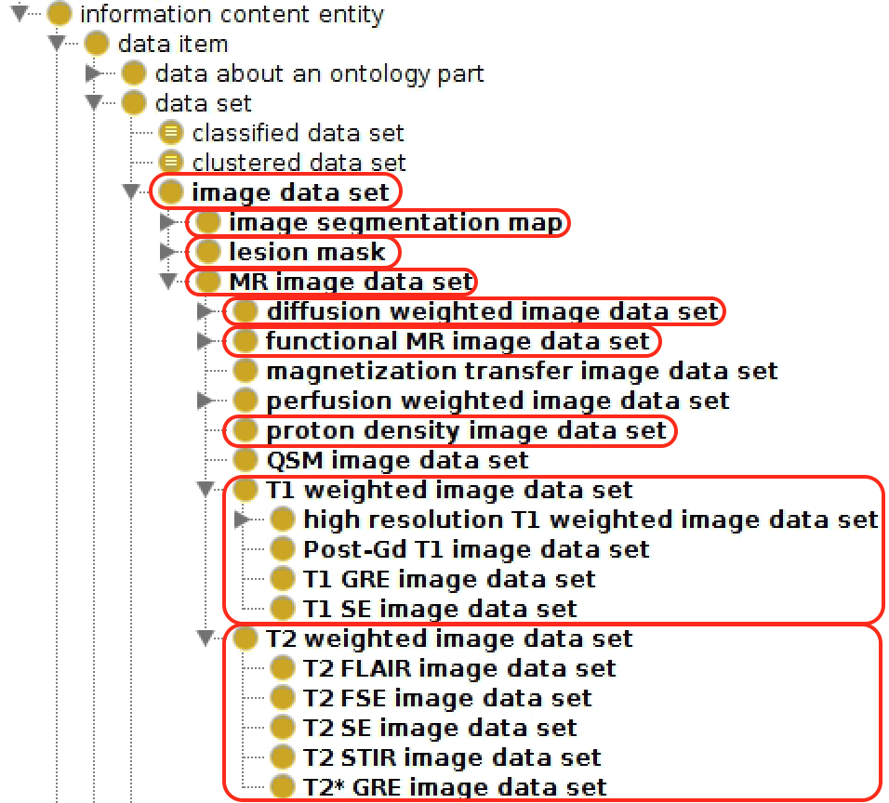
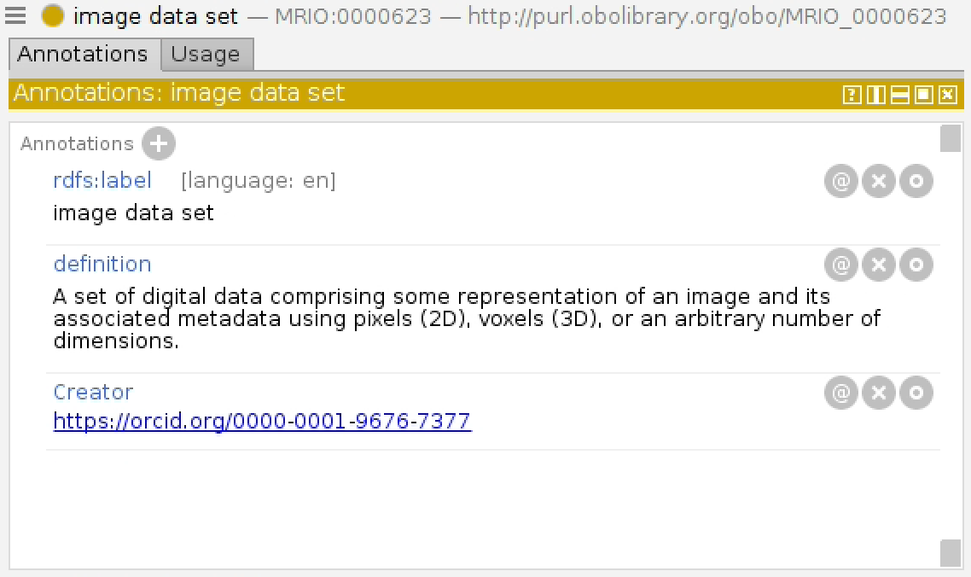
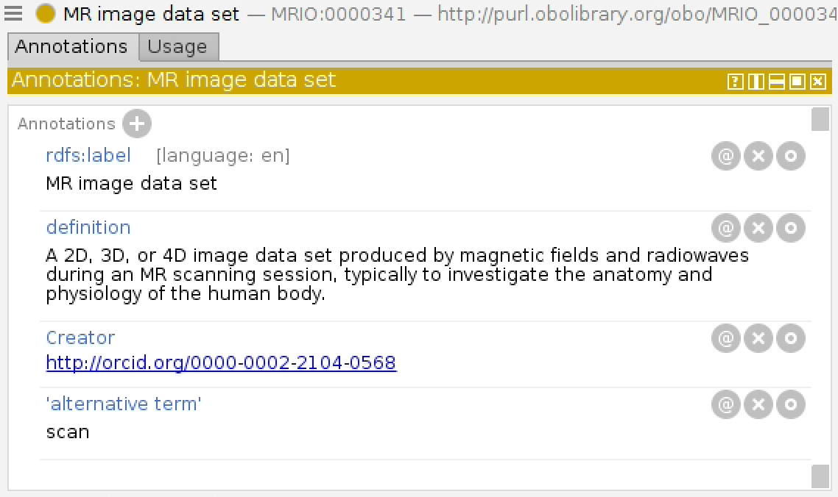
Image data set

Slide 23
‘image data set’ vs image
Why not image (IAO_0000101)?
image is specifically defined as two dimensional, but MRI and many biomedical imaging techniques typically encode data pertaining to three or four dimensions
image is a subclass of figure, which emphasizes the importance of some two dimensional arrangement of ICE’s relating information to an entity
Biomedical imaging DICOM headers (metadata) also encode information about the scanner, protocol, and subject in addition to just color/luminosity in two dimensions
Thus, we have a need for a more general term for an information content entity that more fully represents the different kinds of information found in an MRI scan.
The definition for data set states that it is a collection of data items (e.g. scan, scanner settings, subject data, etc.) that have something in common (i.e. the participant). We felt this sufficient for the parent class of image data set.

Slide 24
Use of image data set
We believe that a general image data set class has utility beyond the domain of MRI/neuroimaging
Applies to any biomedical images in DICOM format (CT, PET, etc.)
Flexibility in n-dimensions allows for potential use beyond static, two dimensional images
Animations, time series, etc.
Many digital image file formats contain headers bearing additional information (e.g. date, location, color space, etc.) that aren’t adequately captured in the image class

Slide 25
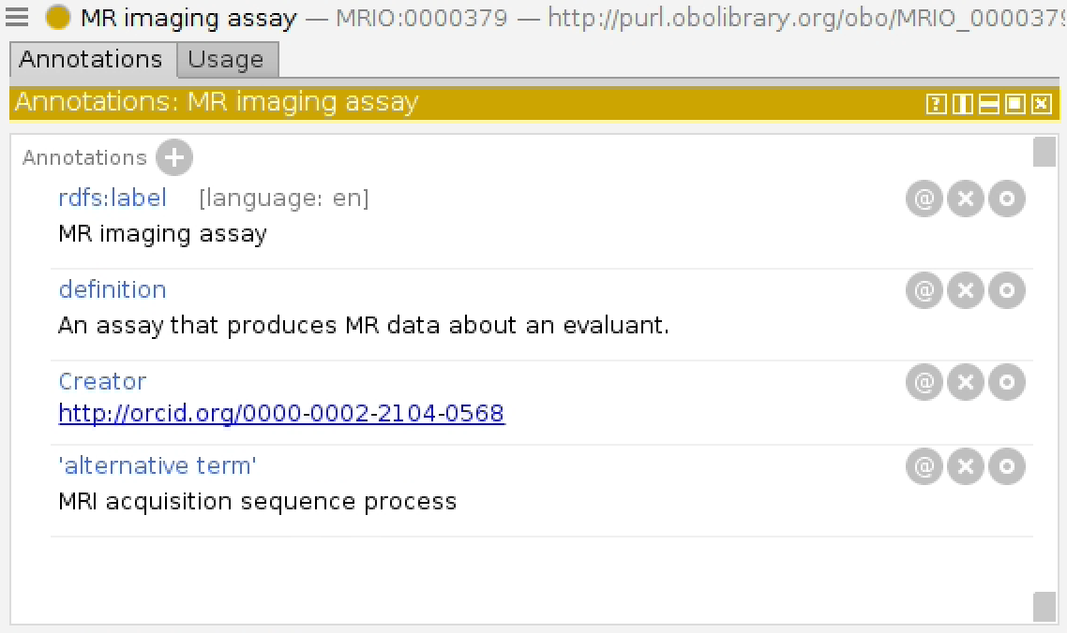
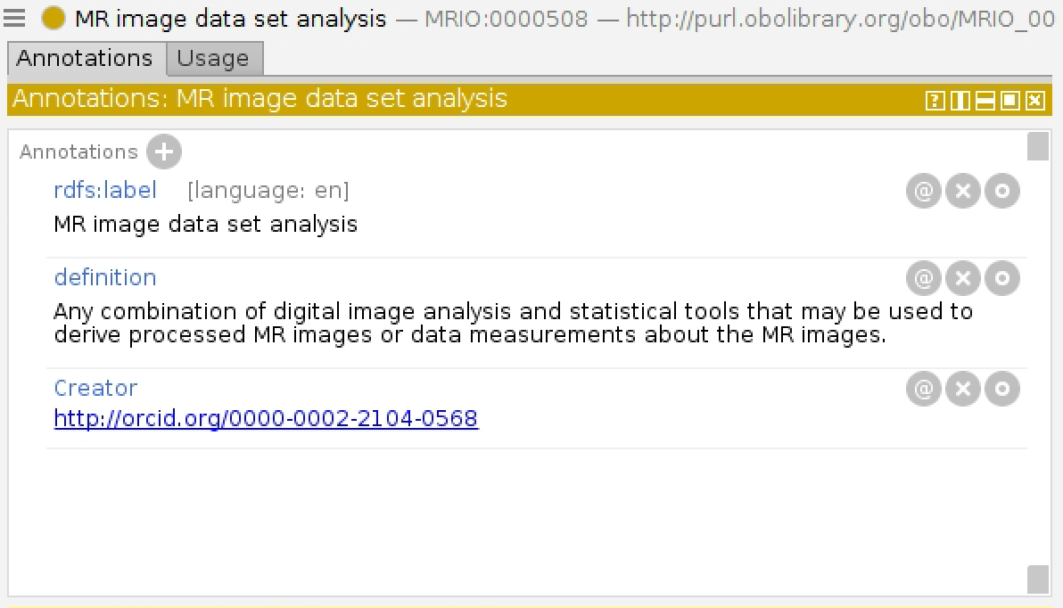
Planned processes

Slide 26
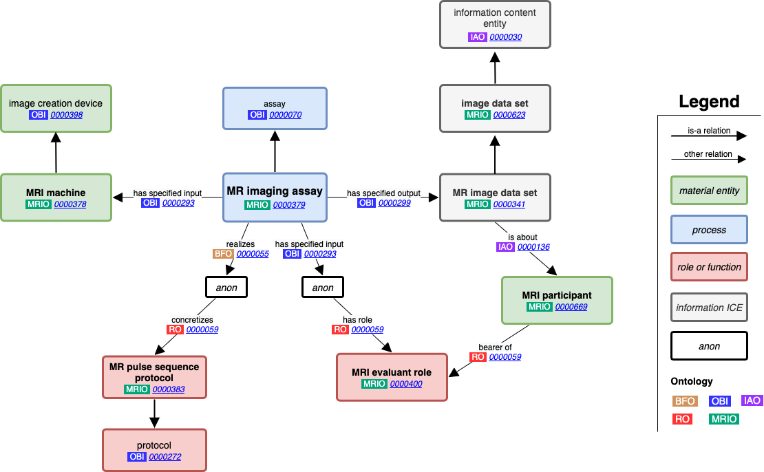
MR Imaging Assay

Slide 27
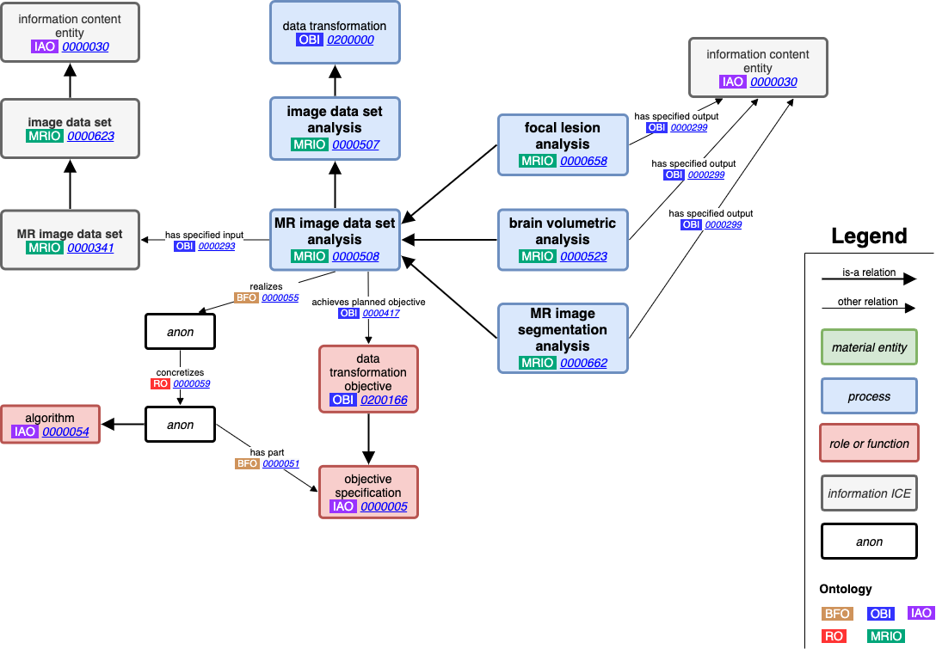
MR Image Data Set Analysis

Slide 28
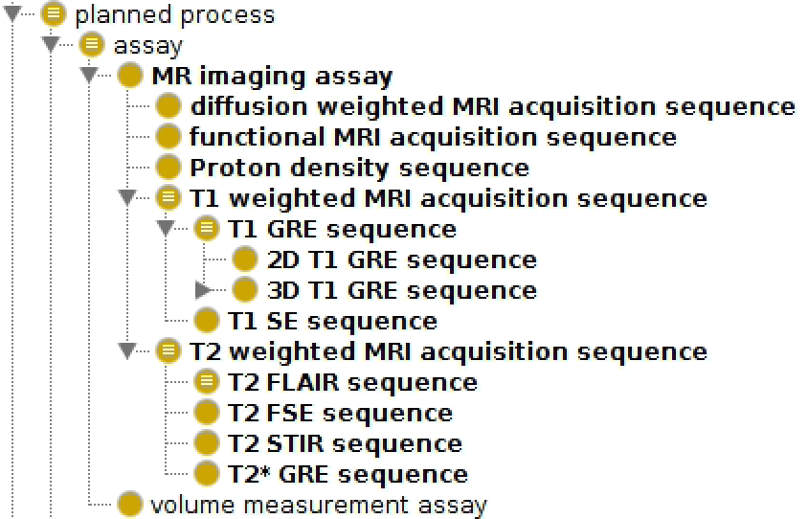
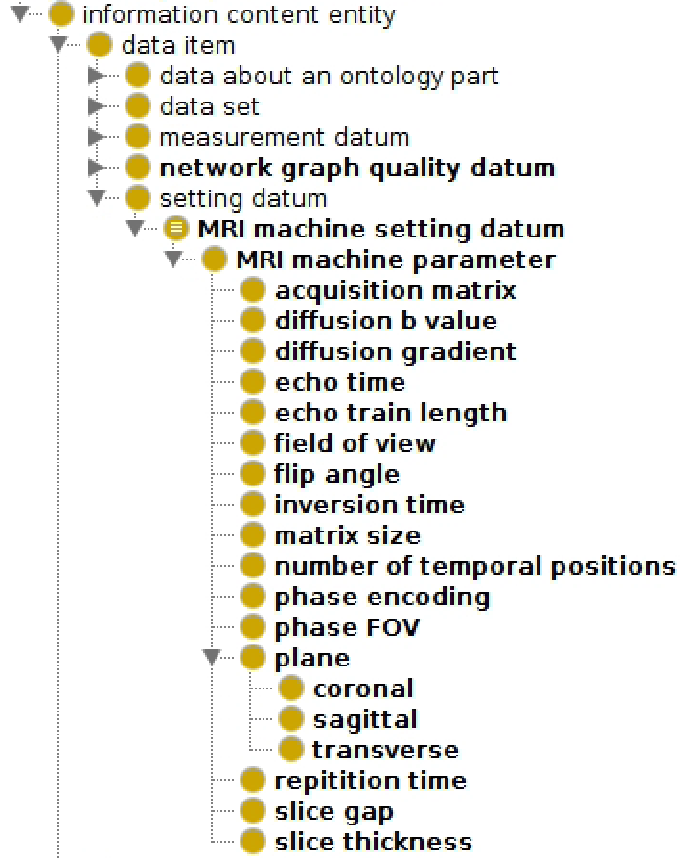
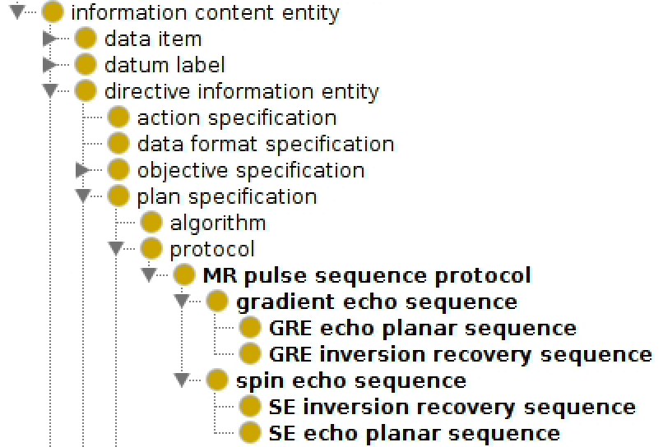
MR Image Acquisition
Different MRI scans can be acquired by using different RF pulse sequences and adjusting MRI machine settings.
Each MRI imaging assay subclass includes logical definitions based on common acquisition parameters for that scan type

Slide 29
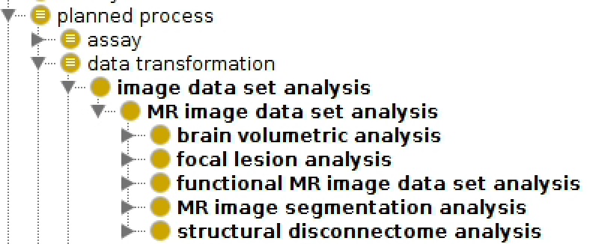
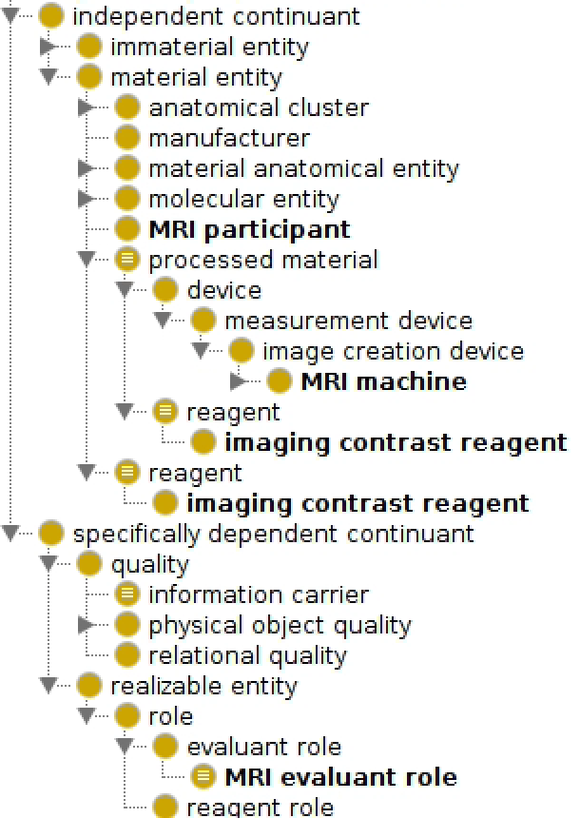
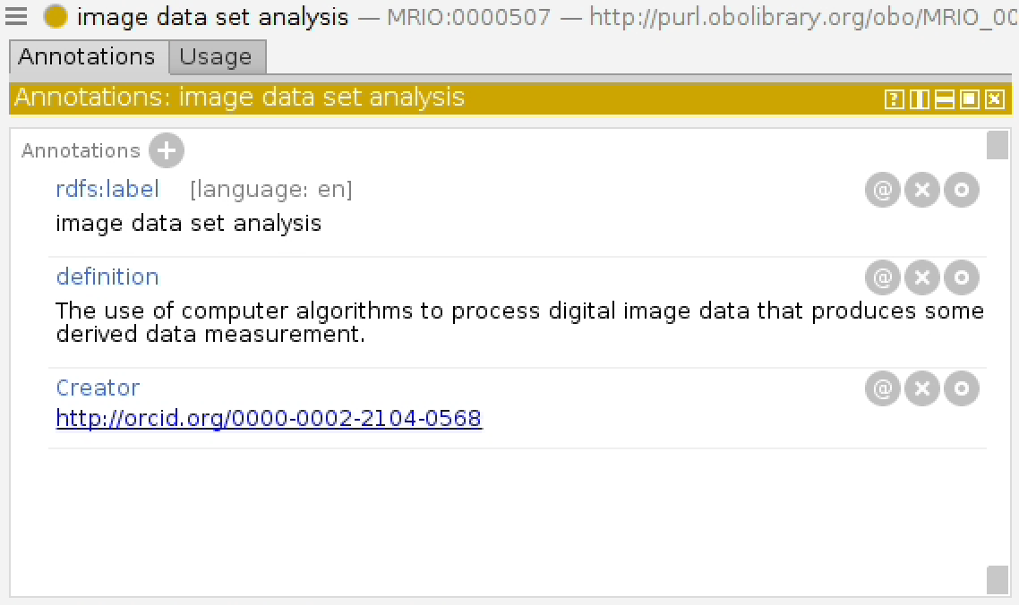
MRI Analysis

Slide 30
Scan Classification

Slide 31
DICOM Headers
“DICOM® is the international standard to transmit, store, retrieve, print, process, and display medical imaging information”
From https://www.dicomstandard.org/, (Mildenberger et al, 2002)
Different kinds of MRI scans may be acquired by tuning machine settings to contrast properties of tissue
Short TE, short TR -> T1 weighted MRI
Long TE, long TR -> T2 weighted MRI
DICOM encodes these acquisition settings in the file header
Pulse sequence used (spin echo vs. gradient echo), TE, TR, FA, inversion time (TI), echo number, echo train length, etc.
Many software tools exist that automatically extract information from DICOM headers
Possible to annotate data from DICOM headers according to MRI acquisition parameters defined in MRIO

Slide 32
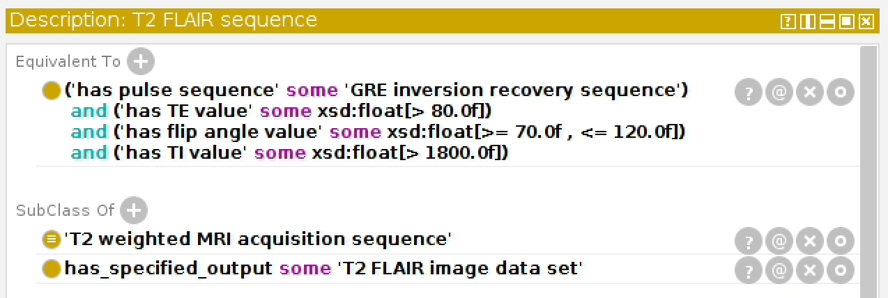
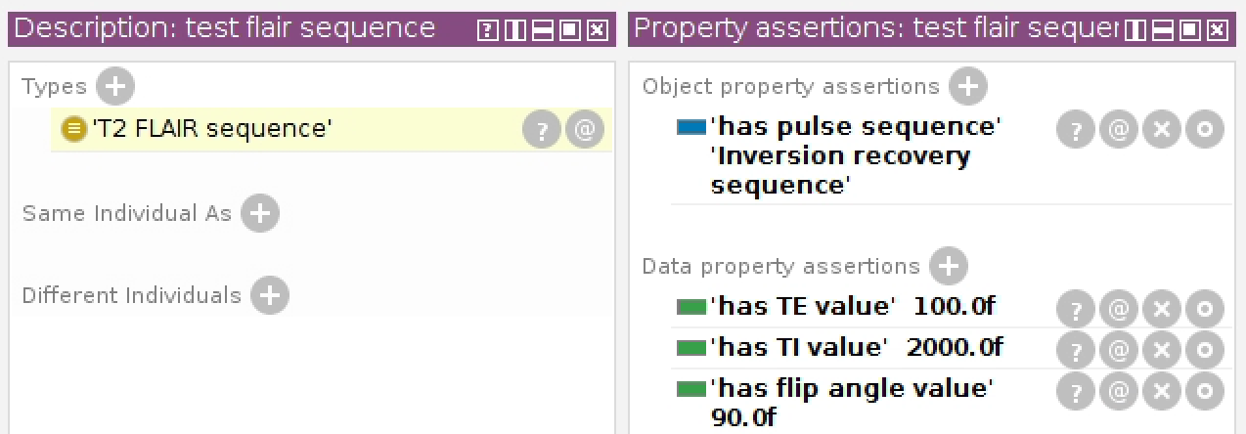
Classifying a T2 FLAIR sequence individual
HermiT reasoner

Slide 33
Use Cases
Integration with BIDS spec
Automated assignment of analyses for all scans in a session
Querying a relational database

Slide 34
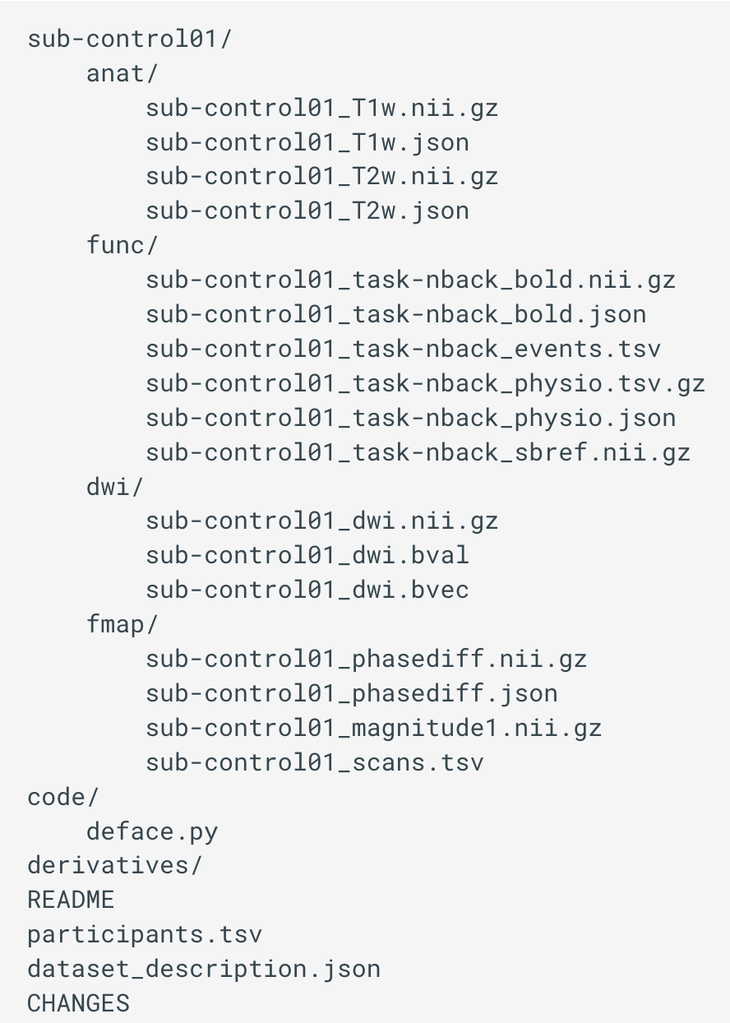
Brain Imaging Data Structure, or BIDS
Standard specification for storing and organizing neuroimaging data
Mostly MRI, but also supports PET, MR spec, EEG
Sort data according to scan type (similar to MRIO)
Developed by Poldrack Lab at Stanford, very young but gaining adoption
DICOM is very old, BIDS is still new
BIDS Apps
Modular neuroimaging analysis tools that work on any BIDS compliant dataset without needing to manually specify data
One goal is to use MRIO and SPARQL queries to generate a BIDS dataset from an unsorted DICOM directory
Classify scans
Map MRIO labels to BIDS folder names
String processing to rename and move files

Slide 35
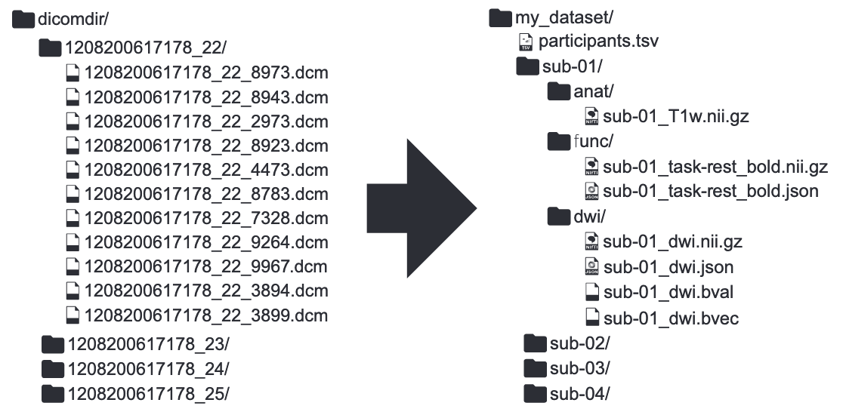
Use of MRIO/SPARQL to transform DICOM -> BIDS

Slide 36
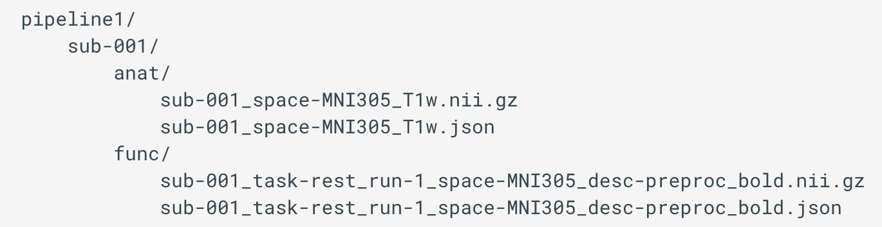
BIDS and derived data
BIDS has built in support for handling results derived from neuroimaging analyses and processing pipelines
BIDS derivatives directory can hold an arbitrary number of subdirectories named after the analysis/pipeline used
Pipeline directories may follow the same specification as BIDS proper and allows for annotations of data using standard conventions in the file name
Each MR image data set analysis subclass can be a subdirectory in a BIDS derivatives directory
Specified outputs of analyses may be used to automatically annotate file names of results for BIDS

Slide 37
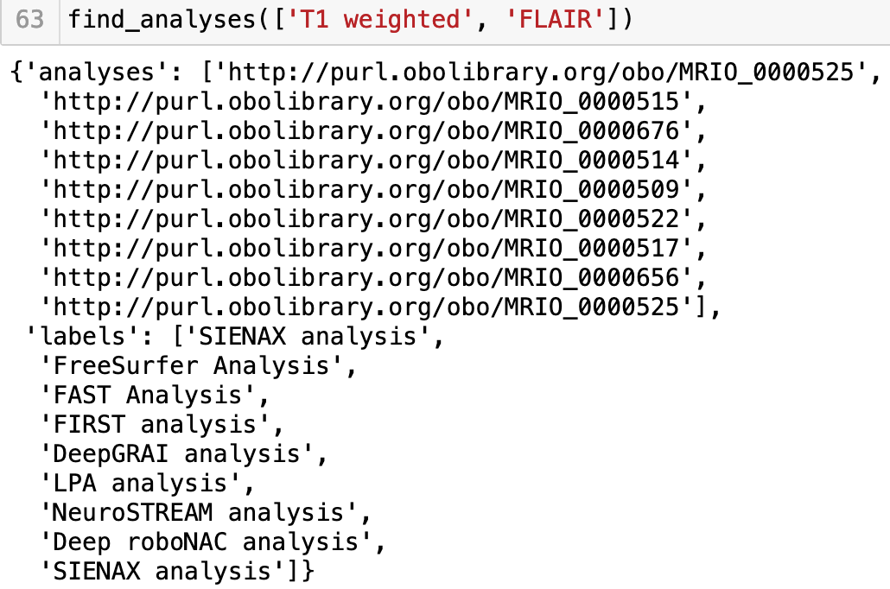
Use of MRIO/SPARQL to assign analyses
Scenario:
A researcher collects MRI scans as part of a larger study (T1 and T2 FLAIR for each subject)
They want to know what kinds of analyses they can do with these scans and what the results mean
The researcher can query MRIO and find all the pertinent analyses for T1 weighted and T2 FLAIR scans, as well as further information on the types of analyses and results
Current state hashes class labels to MRIO IRIs for each scan type
Potential for robust querying system using NLP to map user inputs to MRIO IRIs for SPARQL queries
Credit: Mackenzie Smith for developing the SPARQL query and function

Slide 38
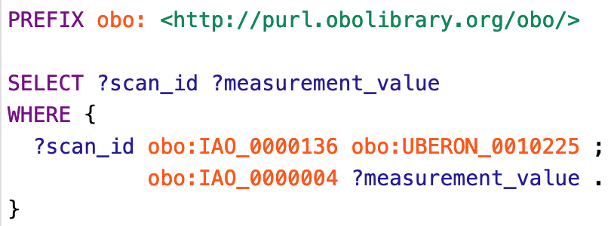

Ontop* and XNAT** Database Integration
Simple English:
“Find anything that is about some thalamus, and has some measurement value”
Because ‘thalamic volume measurement datum’ ‘is about’ some thalamus, results of thalamic volumetry analyses are returned for this query
*Calvanese et al, 2016
**Marcus et al, 2007

Slide 39
Conclusion
MRIO integrates with existing neuroimaging standards (DICOM, BIDS)
MRIO is under active development
MRIO is intended to extend OBI, with contributions of higher level terms
Clear need for an image data set class in the realm of digital and biomedical imaging
image segmentation class has utility beyond biomedical imaging (machine learning/computer vision)
Classes for MR image acquisition and analysis bring OBI into the realm of biomedical/neuroimaging

Slide 40
Terms to contribute
All terms are semantically and logically defined according to OBI standards

Slide 41
Action items
How to proceed?
Under active development, so some more specific terms subject to change
Higher level terms presented fully defined and ready to review for contribution
How best to contribute?
Currently build with ODK/ROBOT, should we use this while contributing to OBI?
Also defined some generic measurement value/datum subclasses for outputs of analyses, should these go in OBI?

Slide 42
Acknowledgements
Lucas Serra
Mackenzie Smith
William Duncan
Lauren Wishnie
Michael Dwyer
Alexander Diehl

Slide 43
Work cited
﻿Plewes DB, Kucharczyk W. Physics of MRI: A primer. Journal of Magnetic Resonance Imaging. 2012;35(5):1038-54.
de Castro Caparelli, Elisabeth. "Exploring brain circuitry: Simultaneous application of Transcranial Magnetic Stimulation and functional Magnetic Resonance Imaging." Neuroimaging (2010): 25.
Gorgolewski, K. J., Auer, T., Calhoun, V. D., Craddock, R. C., Das, S., Duff, E. P., Flandin, G., Ghosh, S. S., Glatard, T., Halchenko, Y. O., Handwerker, D. A., Hanke, M., Keator, D., Li, X., Michael, Z., Maumet, C., Nichols, B. N., Nichols, T. E., Pellman, J., … Poldrack, R. A. (2016). The brain imaging data structure, a format for organizing and describing outputs of neuroimaging experiments. Scientific Data, 3(1), 160044. https://doi.org/10.1038/sdata.2016.44
Poldrack, R. A., & Gorgolewski, K. J. (2014). Making big data open: data sharing in neuroimaging. Nat Neurosci, 17(11), 1510–1517. https://doi.org/10.1038/nn.3818
Biswal, B. B., Mennes, M., Zuo, X.-N., Gohel, S., Kelly, C., Smith, S. M., Beckmann, C. F., Adelstein, J. S., Buckner, R. L., Colcombe, S., Dogonowski, A.-M., Ernst, M., Fair, D., Hampson, M., Hoptman, M. J., Hyde, J. S., Kiviniemi, V. J., Kötter, R., Li, S.-J., … Milham, M. P. (2010). Toward discovery science of human brain function. Proceedings of the National Academy of Sciences, 107(10), 4734. https://doi.org/10.1073/pnas.0911855107
Serra, L. (2019). Early steps of an Ontology for Magnetic Resonance Imaging: MRIO.
Smith, B., Kumar, A., & Bittner, T. (2005). Basic Formal Ontology for bioinformatics. IFOMIS Reports, 1–16.
Bandrowski, A., Brinkman, R., Brochhausen, M., Brush, M. H., Bug, B., Chibucos, M. C., Clancy, K., Courtot, M., Derom, D., Dumontier, M., Fan, L., Fostel, J., Fragoso, G., Gibson, F., Gonzalez-Beltran, A., Haendel, M. A., He, Y., Heiskanen, M., Hernandez-Boussard, T., … Zheng, J. (2016). The Ontology for Biomedical Investigations. PLoS One, 11(4), e0154556. https://doi.org/10.1371/journal.pone.0154556
Smith, B., & Ceusters, W. (2015). Aboutness: Towards foundations for the information artifact ontology. CEUR Workshop Proceedings, 1515, 1–5.
Mildenberger, P., Eichelberg, M., & Martin, E. (2002). Introduction to the DICOM standard. European Radiology, 12(4), 920–927. https://doi.org/10.1007/s003300101100
Calvanese, D., Cogrel, B., Komla-Ebri, S., Kontchakov, R., Lanti, D., Rezk, M., Rodriguez-Muro, M., Xiao, G., & Corcho, Ó. (2016). Ontop: Answering SPARQL Queries over Relational Databases. Semantic Web, 8(3), 471–487.
Marcus, D. S., Olsen, T. R., Ramaratnam, M., & Buckner, R. L. (2007). The Extensible Neuroimaging Archive Toolkit: an informatics platform for managing, exploring, and sharing neuroimaging data. Neuroinformatics, 5(1), 11–34. https://doi.org/10.1385/ni:5:1:11

